Slide 1
All Tools Data Analysis Project
During our training at
National Telecommunication Insitute And ITIDA
Full Data Analysis Process with Python
Full Data Analysis Process with SQL
Full Data Analysis Process with Excel

Slide 2
Our Dataset Talk About
Project Goal: Analyze song performance, compare songs by genre, language,
duration, and explicit content, and extract valuable insights to support decision
making in the music industry
Key dimensions covered in the dataset include:
• Song Attributes: [song_title], [artist], [album], [genre],
[language], [duration]
• Performance Metrics: [popularity], [stream]
• Classifications: [explicit_content], [popularity_level],
[streams_level], [duration_minute], [date_group]
• Production Data: [composer], [producer]

Slide 3
Our Full Data Analysis Process with Excel
. Data cleaning
No duplication
o Deal with outliers
▪ There is outliers in [duration] and its count 349 it will be
deleted
o Deal with nulls
▪ Filling nulls in [language] by mode
▪ Filling nulls in [duration] by mean
▪ Delete [collaboration] Because it contains many nulls = 35000
o Feature Engineering
▪ Create columns like
o popularity_level
o duration_minute
o streams_level
o date_group
▪ the columns that created will Facilitate analysis and comparison
across different groupSteps We Followed:
1-Data Cleaning & Preparation
Steps We Cleaning & Preparation

Slide 4
Our Full Data Analysis Process with Excel
We also performed a complete data analysis process using Excel, leveraging pivot tables, slicers, and
dashboards to ensure data cleaning, interactive exploration, and clear visualization of insights from the Spotify_songs data set
2-Pivot Tables & Slicers
Pivot Tables Built For:
1) Top Music Labels by Number of Songs
2) Average Song Popularity by Label
3) Average Streams: Old vs Recent Songs
4) Average Popularity: Explicit vs Non-Explicit Songs
Slicers Added:

Slide 5
Our Full Data Analysis Process with Excel
Key Insights
Sony Music and Universal Music are the top labels in terms of number of songs.
English songs dominate the dataset, representing about 71% of all songs.
Older songs achieved the highest number and average of streams compared to newer releases.
Recent songs (new/medium) attract fewer streams than older ones.
Sony Music and Universal Music have the highest average popularity, while Indie labels show lower popularity.
There is no significant difference in popularity between Explicit and Non-Explicit songs.
English songs are the most common language for Explicit content.
The largest number of releases occurred in the old period (17,016 songs), while recent years show fewer releases (16,147 songs).

Slide 6
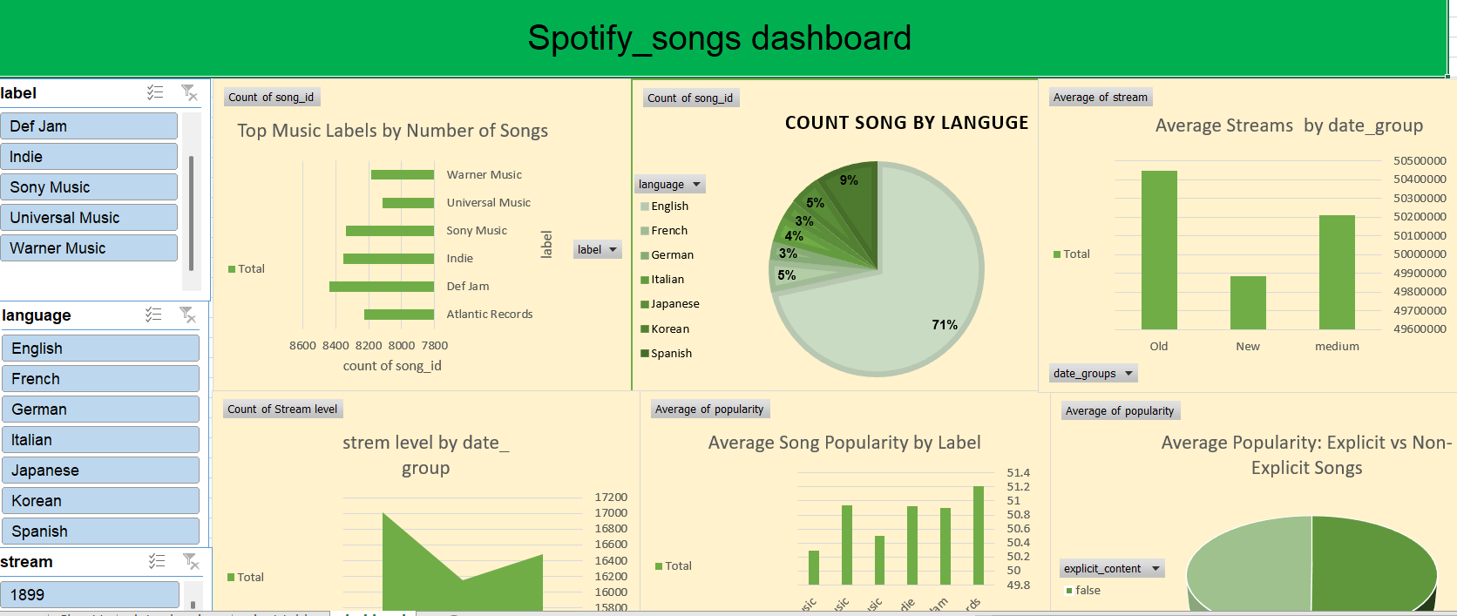

Slide 7
Our Full Data Analysis Process with SQL
z
We also performed a complete data analysis process using SQL to ensure robust validation, efficient querying,
and powerful insights from the Spotify_songs dataset.
DATA EXPLORATION
• Univariate Analysis:
Studied each column separately. For numeric features (popularity,
stream), we used histograms and boxplots to check distributions and
outliers. For categorical features (genre, language,
duration_minute, explicit_content, date_group,
popularity_level, streams_level), we used bar charts and
frequency tables to understand counts and proportions.

Slide 8
Our Full Data Analysis Process with SQL
Data cleaning
No duplication
o Deal with outliers
▪ There is outliers in [duration] and its count 349 it will be
deleted
o Deal with nulls
▪ Filling nulls in [language] by mode
▪ Filling nulls in [duration] by mean
▪ Delete [collaboration] Because it contains many nulls = 35000
o Feature Engineering
▪ Create columns like
o popularity_level
o duration_minute
o streams_level
o date_group
▪ the columns that created will Facilitate analysis and comparison
across different groupSteps We

Slide 9
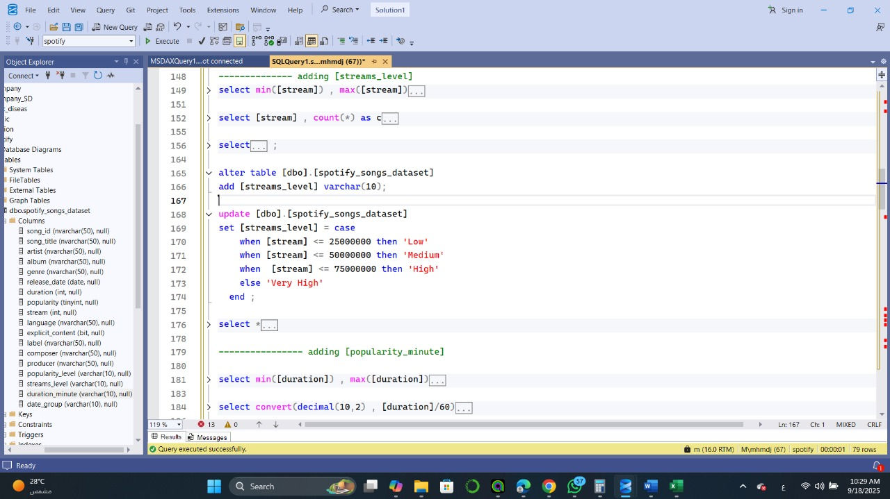
Our Full Data Analysis Process with SQL
Feature Engineering
▪ Create columns like
o popularity_level
o duration_minute
o streams_level
o date_group

Slide 10
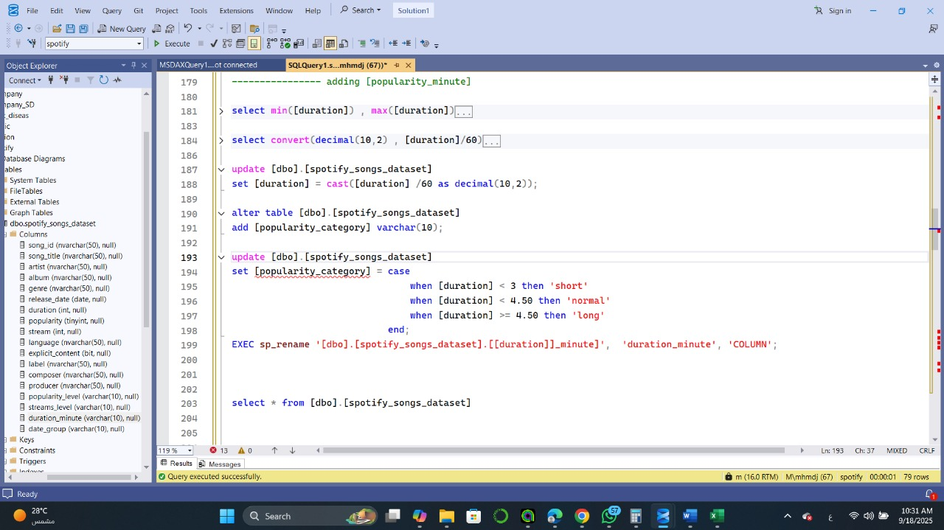
Our Full Data Analysis Process with SQL

Slide 11
Our Full Data Analysis Process with SQL
Key Insights
English songs dominate the dataset, representing about 71% of all songs.
Older songs achieved the highest number and average of streams compared to newer releases.
Recent songs (new/medium) attract fewer streams than older ones.
Sony Music and Universal Music have the highest average popularity, while Indie labels show lower popularity.
There is no significant difference in popularity between Explicit and Non-Explicit songs.
English songs are the most common language for Explicit content.
The largest number of releases occurred in the old period (17,016 songs), while recent years show fewer releases (16,147 songs).

Slide 12
Our Full Data Analysis Process with Python
Import Libraries & Load Files
Imported necessary libraries (Pandas, NumPy, Matplotlib, etc.)
Loaded dataset files into DataFrame
Data Exploration:
- Checked dataset shape (number of rows and columns)
- Checked column data types and null values
- Viewed last rows to inspect data

Slide 13
Data Cleaning
Null Values:
- Checked number of null values in each column
- Dropped rows where all values were null
- Dropped the 'collaboration' column
- Replaced remaining null values with mode (categorical) or mean (numerical)
Duplicates:
- Checked for duplicate rows
- Found no duplicates
Group By & Pivot Table:
- Used groupby() and pivot_table() to summarize and aggregate data

Slide 14
Insights / Key Questions
Q1: Which songs are the most popular?
Q2: Which songs have the highest number of streams?
Q3: Which genre has the highest average popularity?
Q4: Which genre has the highest average streams?
Q5: Are explicit songs more popular than non-explicit songs?
Q6: Do major labels (Universal, Sony, Warner, Def Jam) have higher streams?
Q9: Which languages are most used in songs?
Q10: Which languages have the highest average popularity?
Q11: Which artists released the highest number of songs?
Q12: Which artists achieved the highest total streams?
Q19: Which producers or composers are associated with the most popular songs?
Q20: Which genres produce more explicit songs?

Slide 15
Data Visualization
Bar Charts – Important Categorical Columns: Shows distribution of genres, explicit content, languages, albums, and artists.
Histograms – Numerical Columns: Displays distribution of duration, popularity, and streams.
Pie Chart – Language Distribution: Shows proportion of songs in different languages.

